Slide 1

Section Discussion ListServ
How To
Tech Tips

Slide 2
Today’s Topics
Signing up for the Discussion ListServ
Signing up for a ListServ Management Account
How to manage ListServ preferences
How to review Discussion ListServ archives
Leave the Discussion ListServ
Questions and Problems
Tech Tips and Tricks

Slide 3
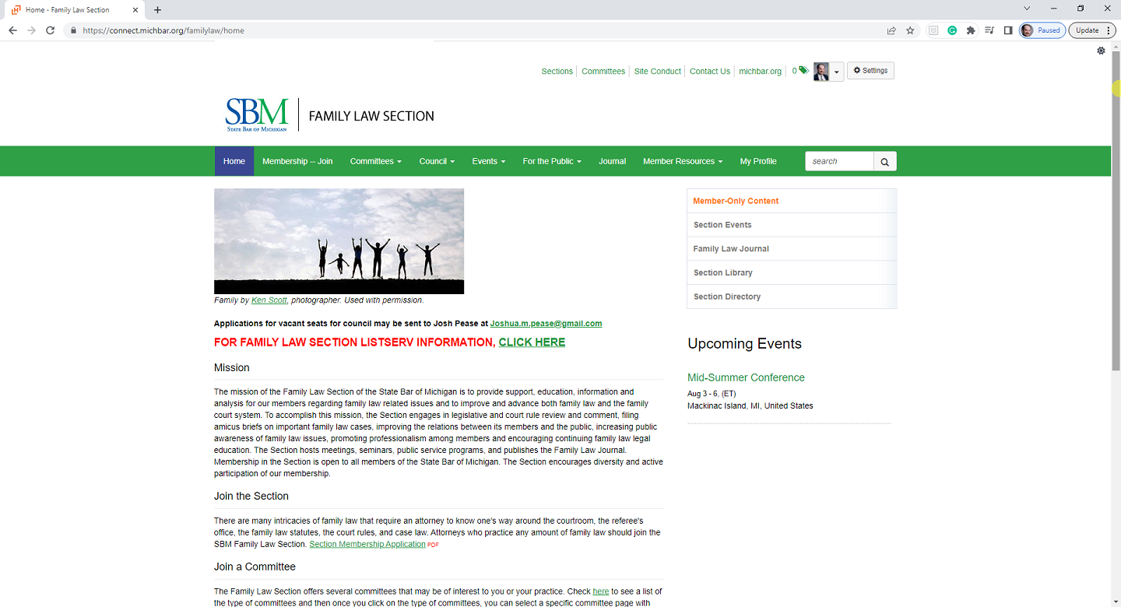
http://mifamilylawattorney.org

Slide 4
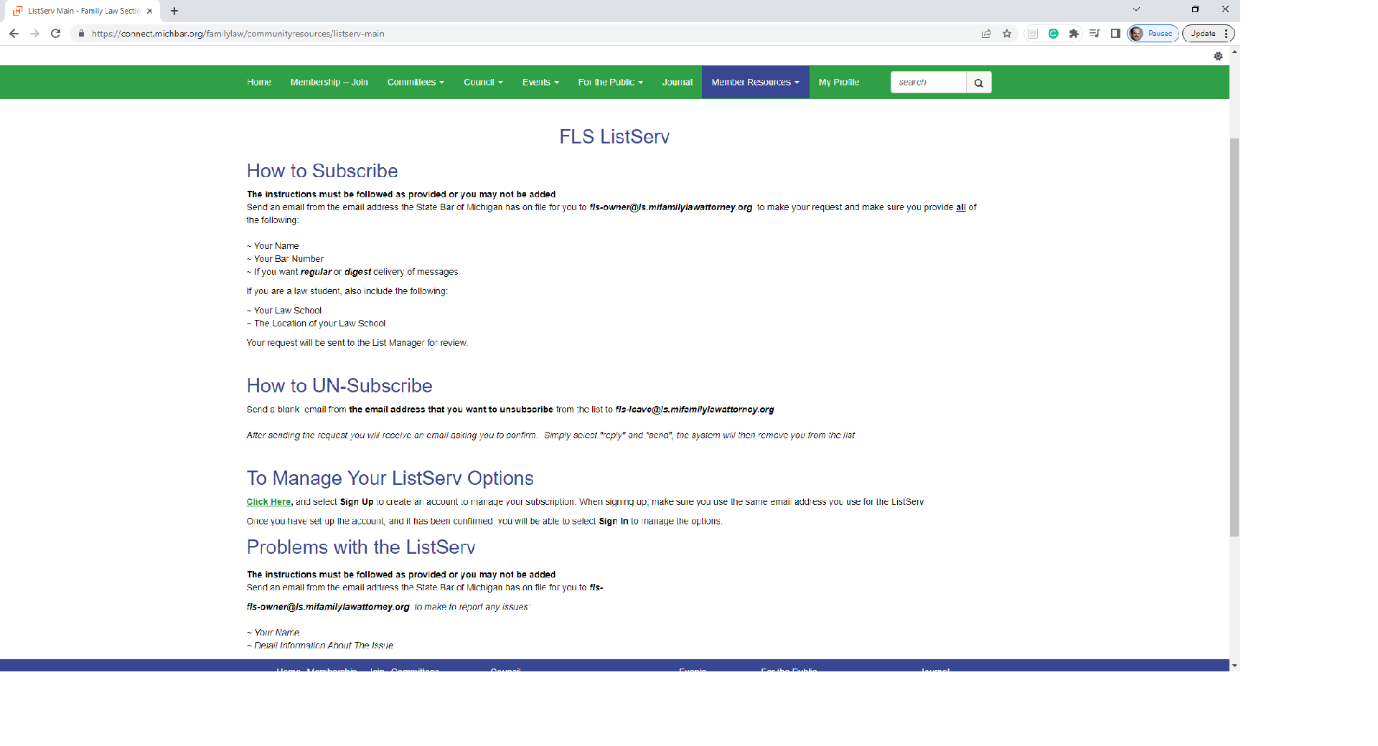

Slide 5
Signing Up For The
Discussion ListServ

Slide 6
Signing Up For The
Discussion ListServ
From your SBM Email address, send email to:
fls-owner@ls.mifamilylawattorney.org
Include the following:
  Your Name
  Your Bar Number
  If you want regular or digest delivery of messages

Slide 7
Delivery Type
Regular Delivery
Messages delivered as received by the
ListServ system
Digest Delivery
Messages held and delivered about once a day

Slide 8
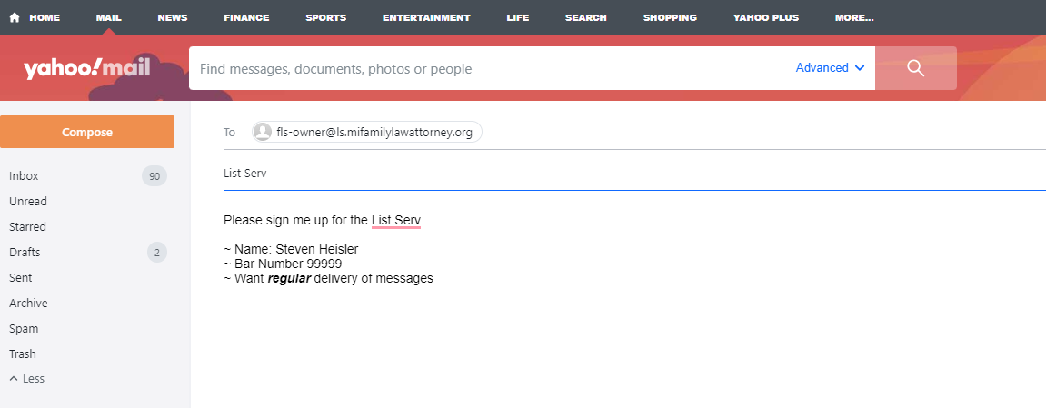

Slide 9
Verification
The ListServ “Owner” (manager) will verify you are a section member.
Verification is a manual task by the Owner
Once verified, you will receive an email requesting you confirm your request to join

Slide 10
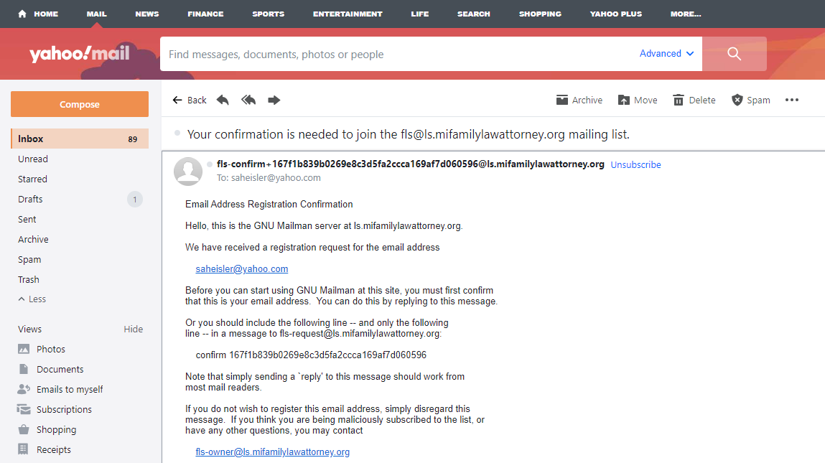

Slide 11
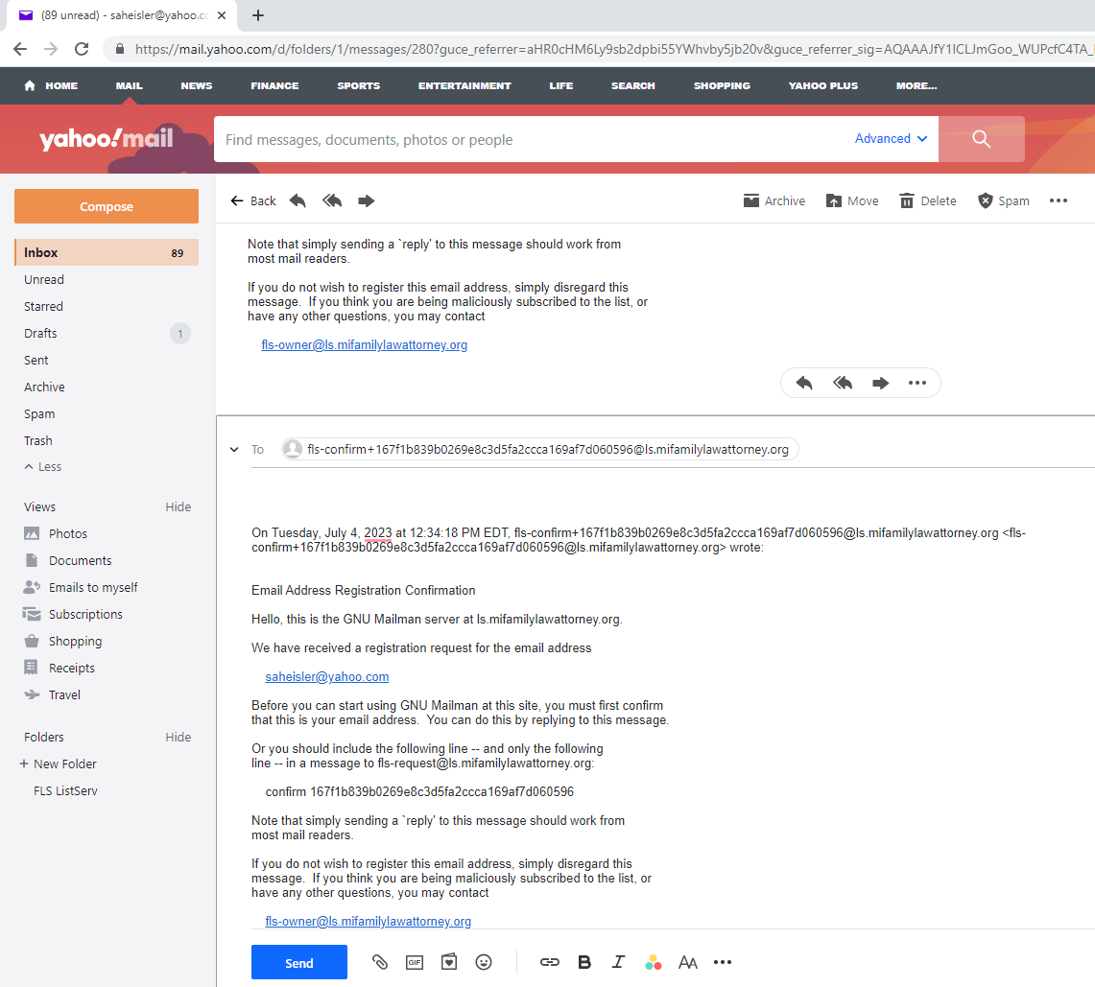

Slide 12
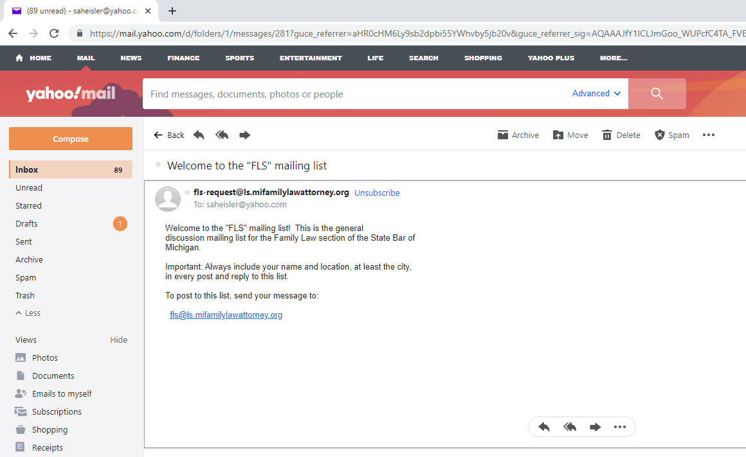
Confirming E-Mail

Slide 13
After Welcome Message
You will start receiving discussion messages
Be able to start a discussion message
Reply to discussion message
fls@ls.mifamilylawattorney.org

Slide 14
Sign Up For A
ListServ Management Account (LSMA)

Slide 15
ListServ Management Account (LSMA)
LSMA is NOT required
LSMA allows management of delivery options
LSMA allows alternative email address
Must already be confirmed on the ListServ
MUST sign up and confirm to use LSMA

Slide 16
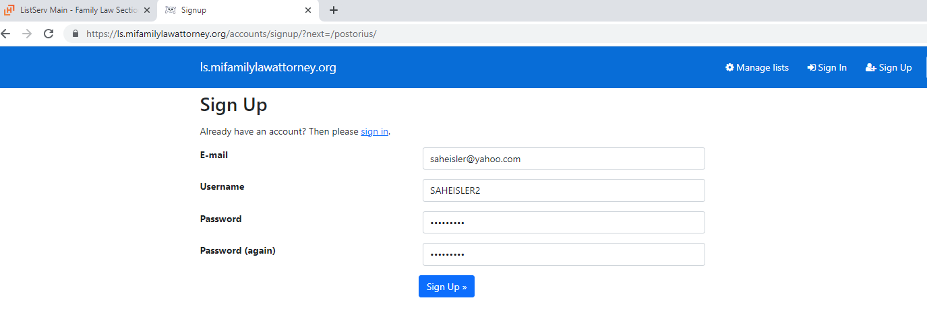
LSMA Sign UP
http://ls.mifamilylawattorney.org

Slide 17
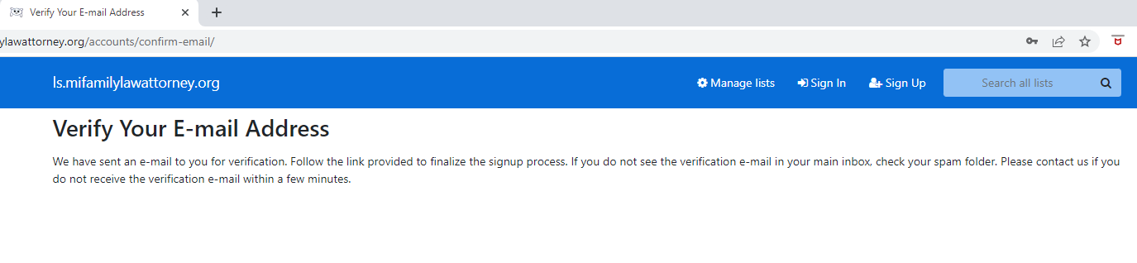
LSMA Verification

Slide 18
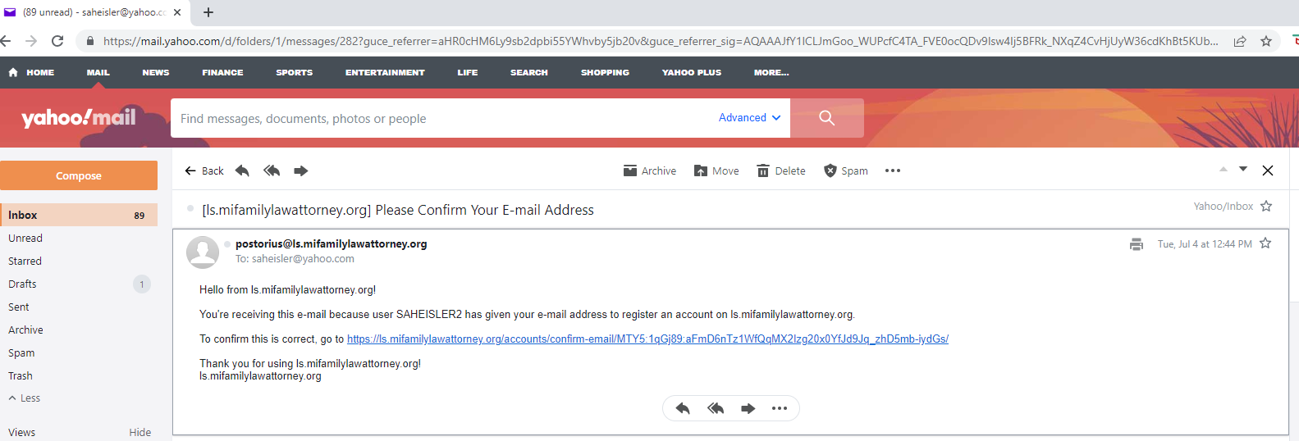
LSMA Verification E-Mail

Slide 19
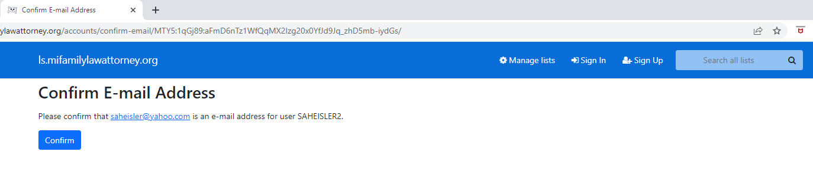
LSMA Verification E-Mail

Slide 20
Using The LSMA To Manage Preferences & Use Archives
After Signing Up For The LSMA

Slide 21
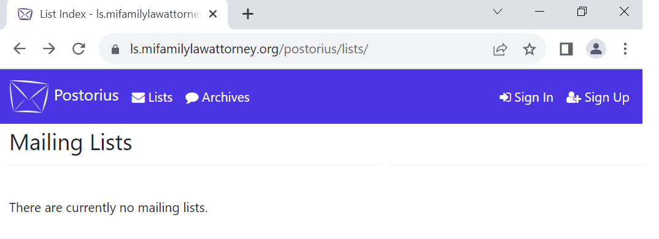
L.S.M.A.
Must have a L.S.M.A.
Go To http://ls.mifamilylawattorney.org

Slide 22
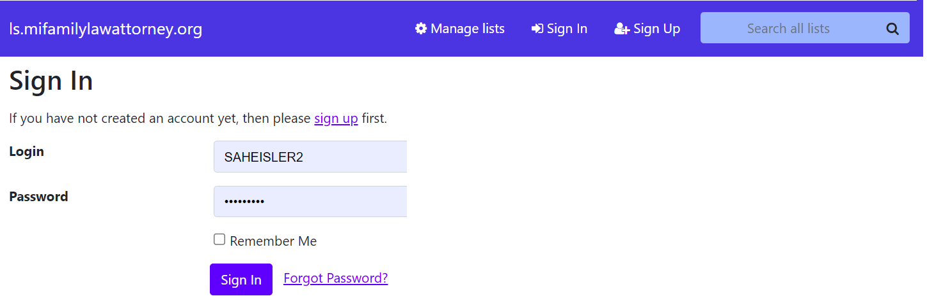
L.S.M.A.
Log in using L.S.M.A. credentials

Slide 23
Using The L.S.M.A. To
Manage Preferences

Slide 24
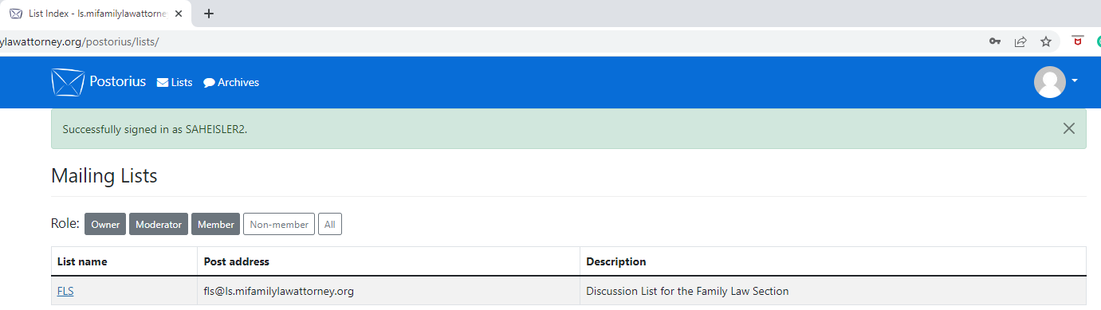
LSMA MAIN MENU

Slide 25
LSMA MAIN MENU

Slide 26
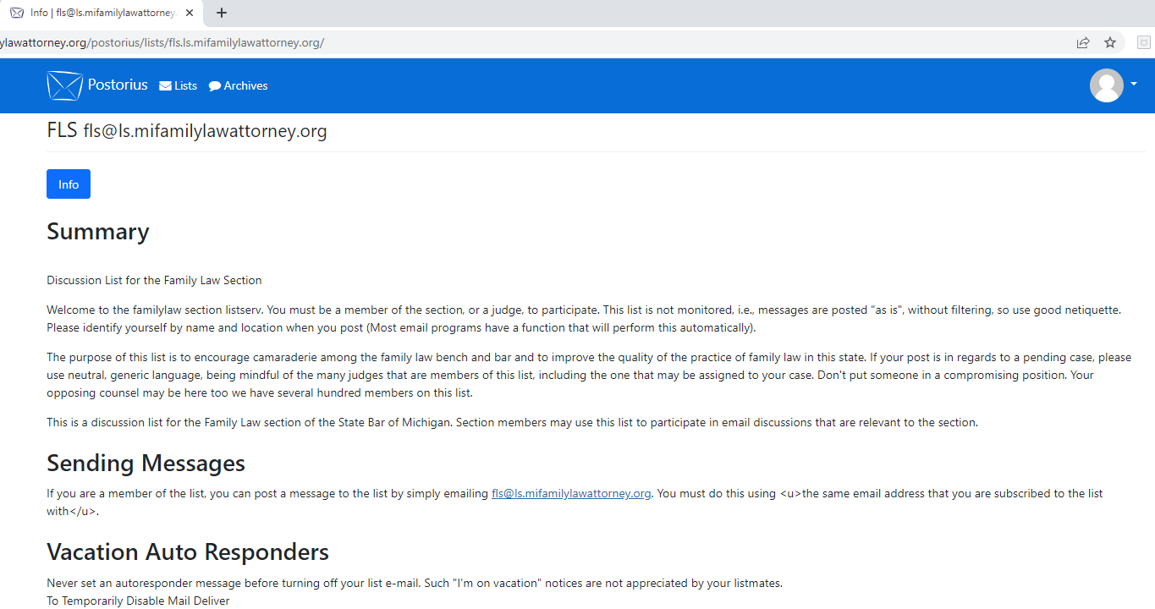
L.S.M.A.

Slide 27
L.S.M.A.

Slide 28
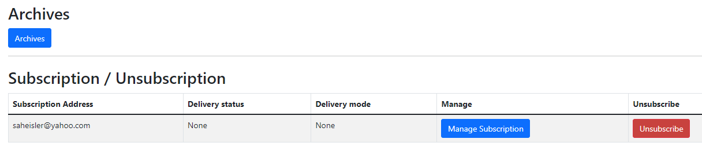
L.S.M.A.
Click Manage Subscription

Slide 29
L.S.M.A.
Click Manage Subscription

Slide 30
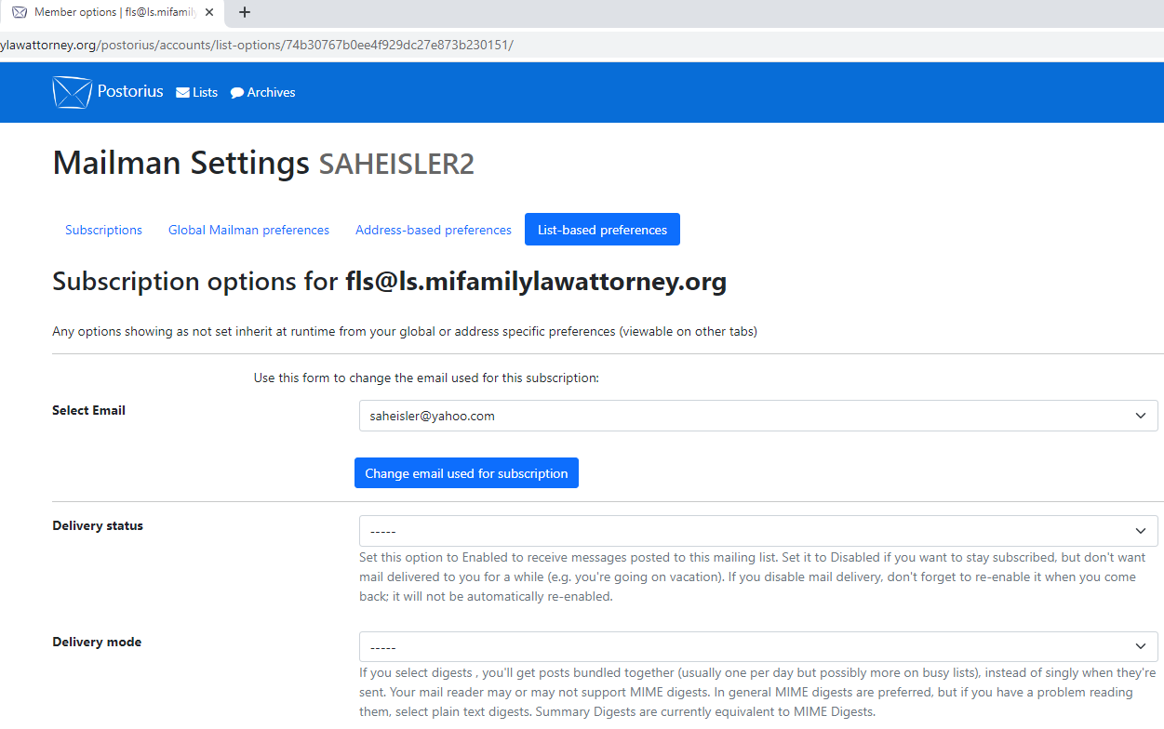

Slide 32
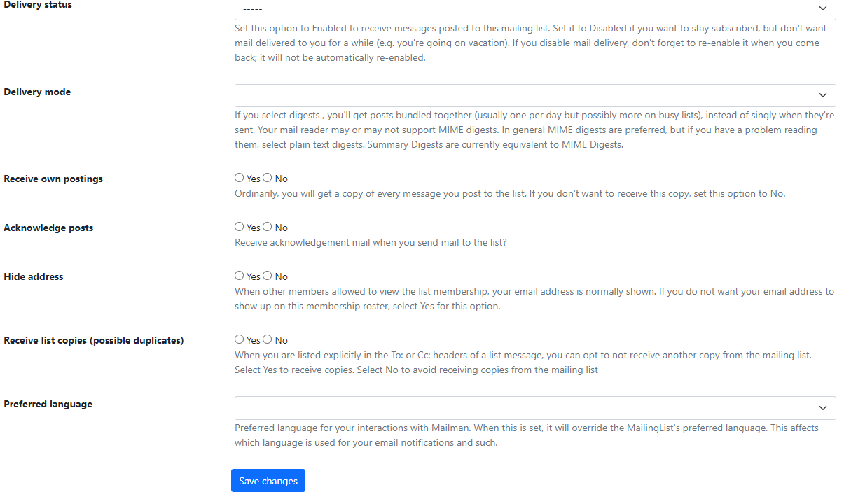

Slide 33
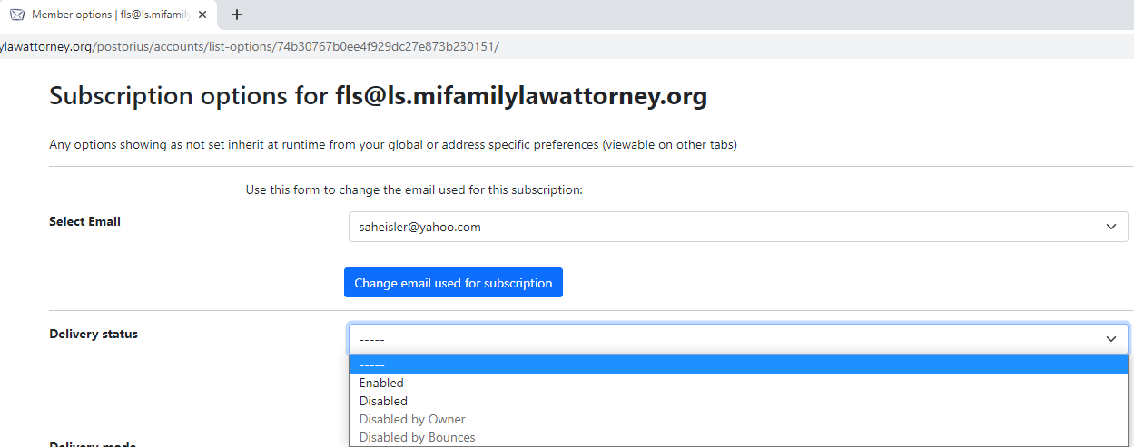
L.S.M.A. Delivery Status

Slide 34
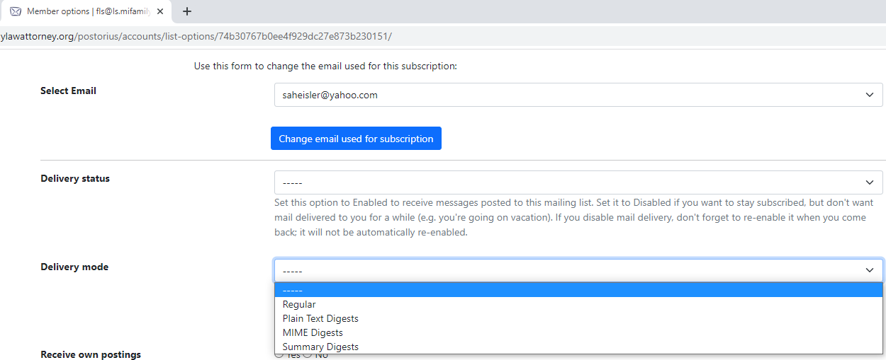
L.S.M.A. Delivery Mode

Slide 36
Using The L.S.M.A. To
Review Archives

Slide 37
Review (Search) Archives
Must have a L.S.M.A.
Go To http://ls.mifamilylawattorney.org

Slide 38
Review (Search) Archives
Must have a L.S.M.A.
Go To http://ls.mifamilylawattorney.org

Slide 39
Review (Search) Archives
Log in using L.S.M.A. credentials

Slide 40
Review (Search) Archives

Slide 41
Review (Search) Archives

Slide 42
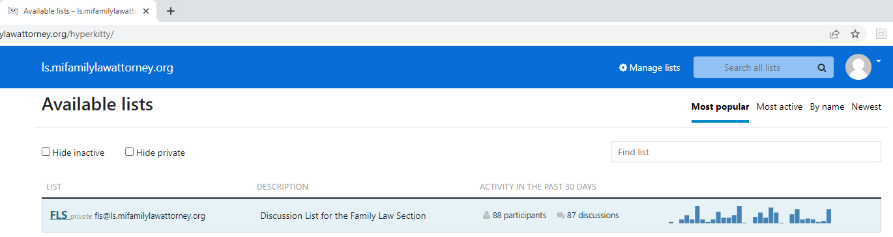
Review (Search) Archives

Slide 43
Review (Search) Archives

Slide 44
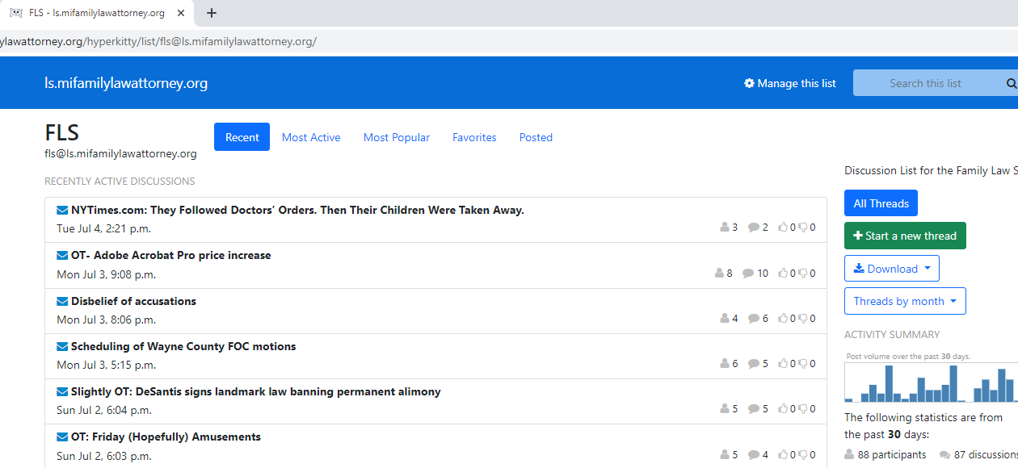
Review (Search) Archives

Slide 45
Review (Search) Archives

Slide 46
Review (Search) Archives
What is there on the ListServ about the Port Huron Judge Elwood Brown

Slide 47
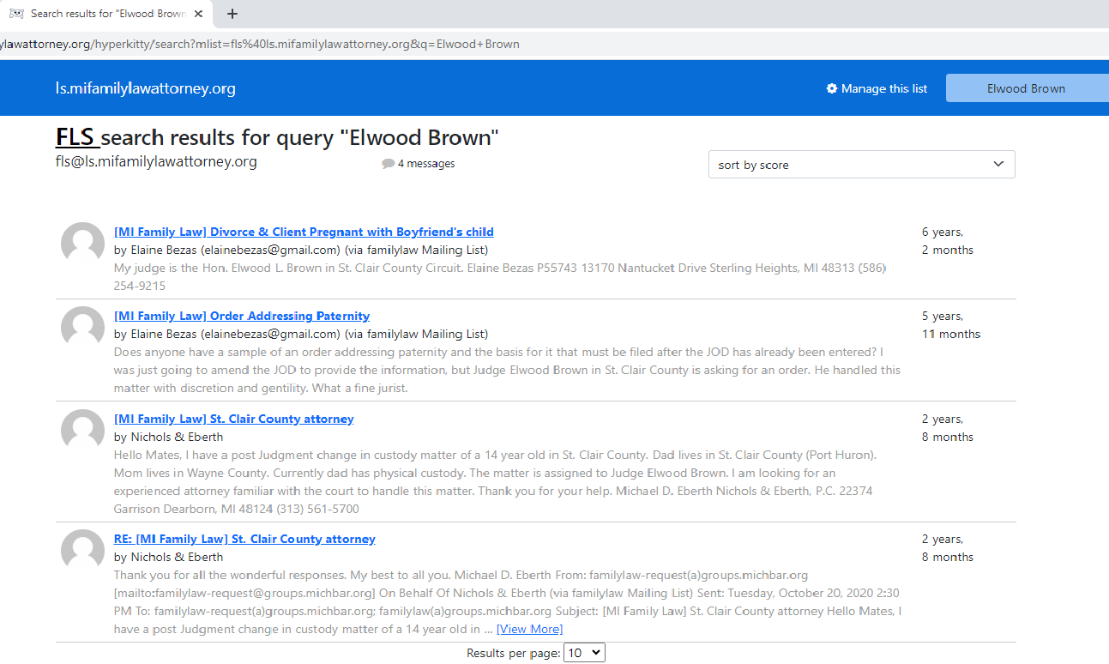
Review (Search) Archives

Slide 48
Review (Search) Archives

Slide 49
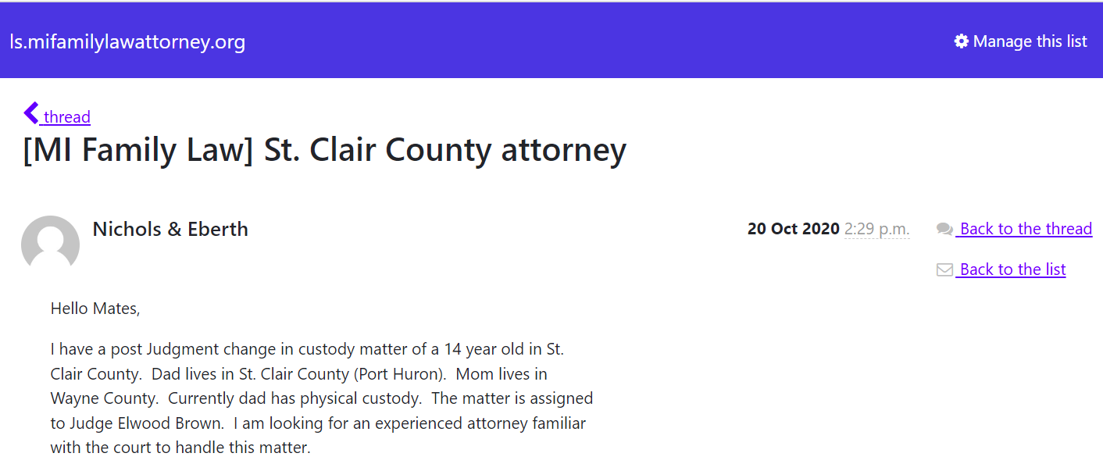
Review (Search) Archives

Slide 50
Review (Search) Archives

Slide 51
Review (Search) Archives
Now you can scroll down to see the thread
Not all messages have a thread
(only one message)
By using REPLY and not sending a NEW message it will become part of the thread and not become a new thread

Slide 52
Leave the Discussion ListServ
If you no longer want to be part of the
ListServ Discussion group just follow these steps
Send an email to
fls-leave@ls.mifamilylawattorney.org
Reply to the confirming email

Slide 53
Questions and Problems
If you have issues or a problem with the ListServ
Just email:
fls-owner@ls.mifamilylawattorney.org
This is ONLY for the Family Law ListServ
Other ListServs may not be the same

Slide 54
Tech Tips and Tricks
And One Lawyer Joke

Slide 55
Tech Tips and Tricks
Electronic Firm Image
What does your email address say about you?
PresidentJoe@aol.com
PresidentDon@msn.com
The last part of your email address is the domain
Own It (the domain)

Slide 56
Tech Tips and Tricks
How would you feel getting a mortgage from a guy that send loan documents from LoanGuyScott@hotmail.com
How would you feel getting having a financial advisor that send you stock tips from MoneyMike@yahoo.com
Then why would YOU use this type of email address????

Slide 57
Tech Tips and Tricks
First Step to a professional e-mail address is the domain
If you already have a website with a domain, you got this part done
You can use the website domain for your email addresses in your firm
If not, you can buy a domain for about $20 a year

Slide 58
Tech Tips and Tricks
Where to buy a domain for websites / emails
Several Options, the section uses:
www.GoDaddy.com
What To Consider in a domain
Easy to remember
Easy to spell
Sorry, www.MichiganDivorce.org is taken

Slide 59
Tech Tips and Tricks
Hosting the Domain
  If you have a website, the provider may be able to provide email boxes too
  Google Workspace by Google
  (starting at about $6 / month / user)
  G Suite has the advantages of GMAIL, but your domain
  Can use Google Apps with your domain

Slide 60
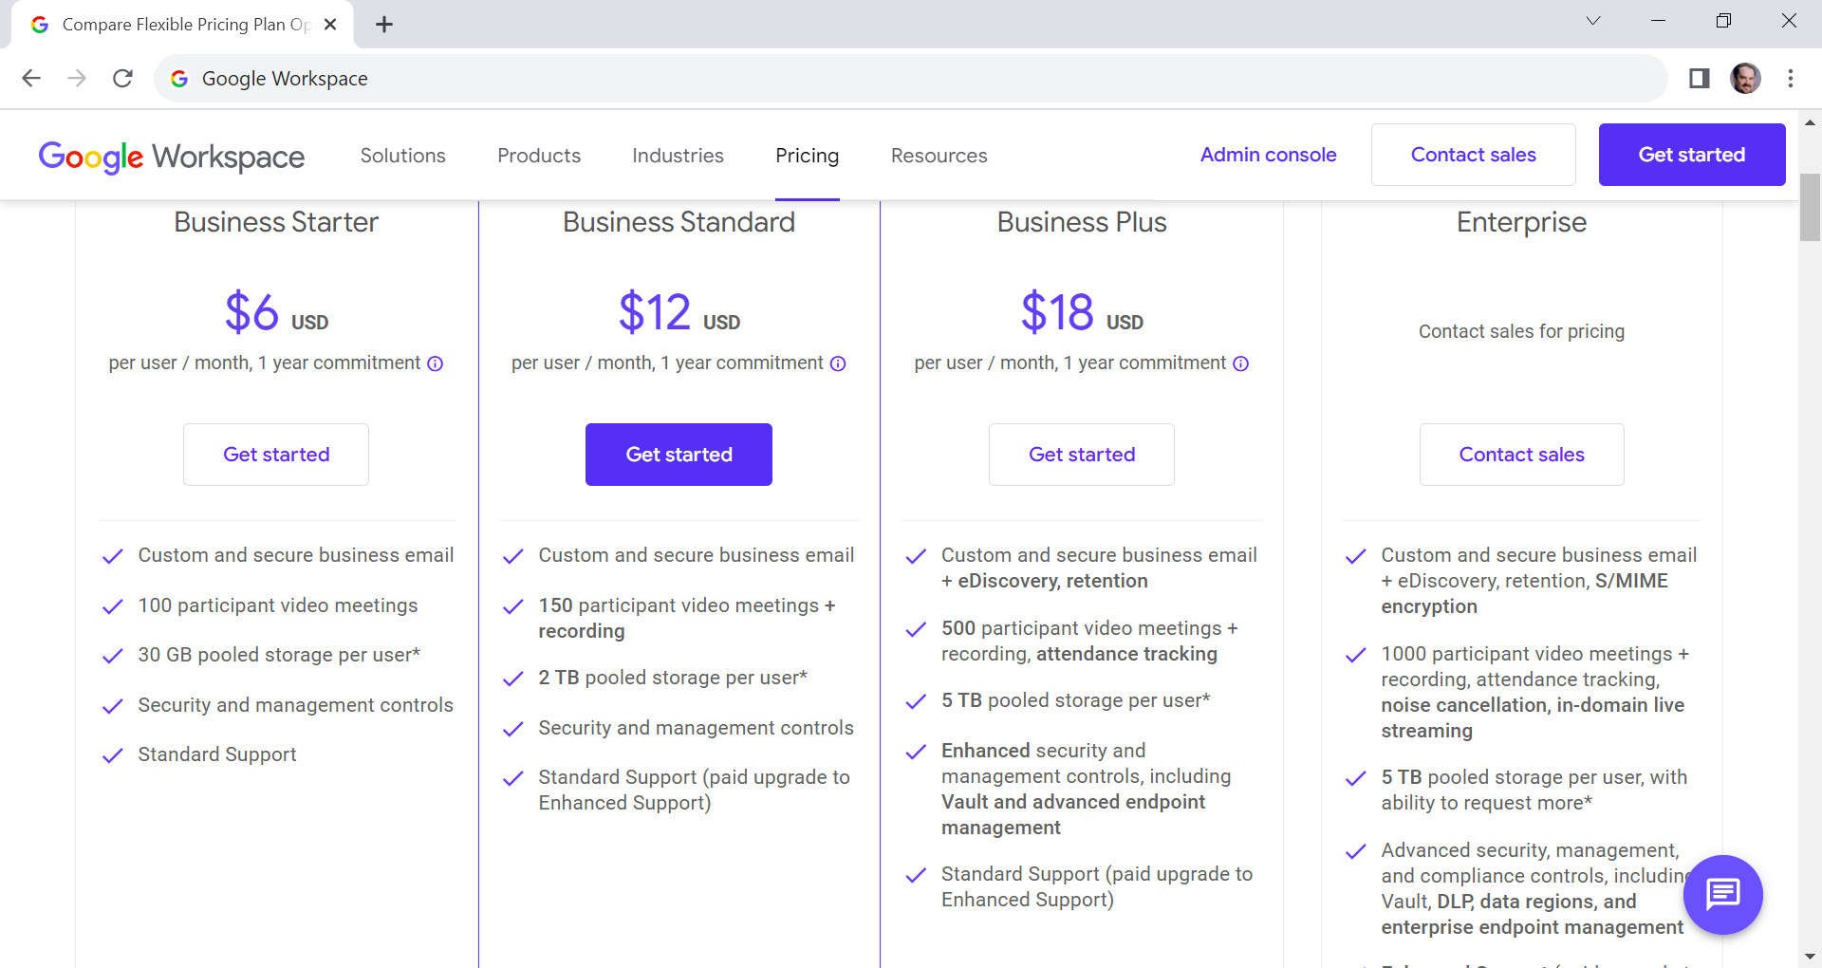
Google Workspace by Google

Slide 61
Tech Tips / Password
  How secure is your passwords?
  Can check at:
  https://www.security.org/how-secure-is-my-password/
  The site will tell you how long it will take to crack your password with an auto character generator
  Mine is 19 characters
  (5 hundred quadrillion years)

Slide 62
Tech Tips / Password
  Please don’t use “password” as your password
  Cracking time
  FIVE SECONDS
  Best to have :
    Letters with upper and lower case
    Numbers
    Symbols (!@#$%^&*)
    Longer is better

Slide 63
Stop Spam Calls At the Office
  Auto Attendant
  Yes people hate them
  Keep them short
  Example:
    Welcome to XYZ Law. If you know your parties extension, dial it now. For our address, hours and fax number press 2, all other calls press 9
    DO NOT HAVE A ZERO OPTION

Slide 64
Stop Spam Calls At the Office
  This can save on answering common questions
  Many auto dialers can’t get to a person
  Does not STOP the calls, just stops the calls getting to a person

Slide 65
Lawyer Joke
  How many jokes are there about lawyers?
  ZERO, none are jokes, they are all true stores based on some attorney somewhere.

Slide 66
THANK YOU
  Thanks for your time
  Hope you enjoyed your time

Slide 67
